Slide 1
“Look how they massacred my boy”
I
>
fix
What we plan to do to this
poor man’s Discord bot
>
Tod Jones
Dakota Methvin
Vince Seely

Slide 2
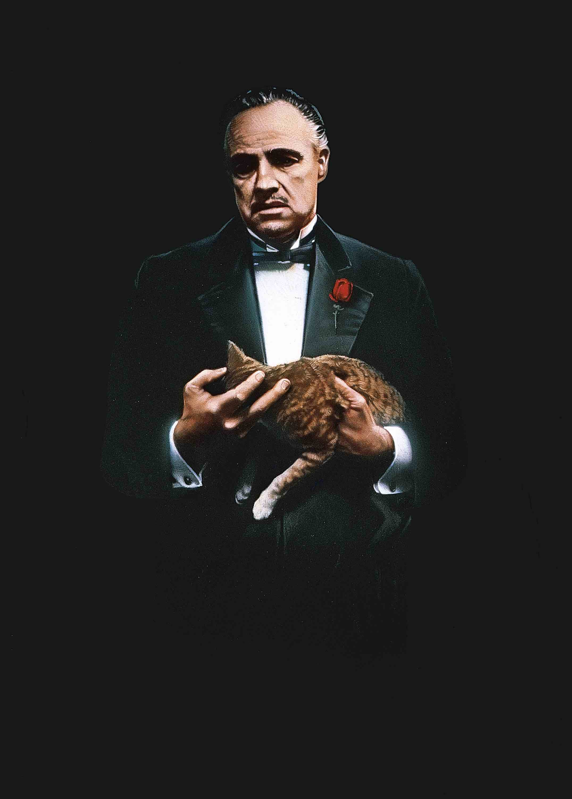
Class Diagram

Slide 3
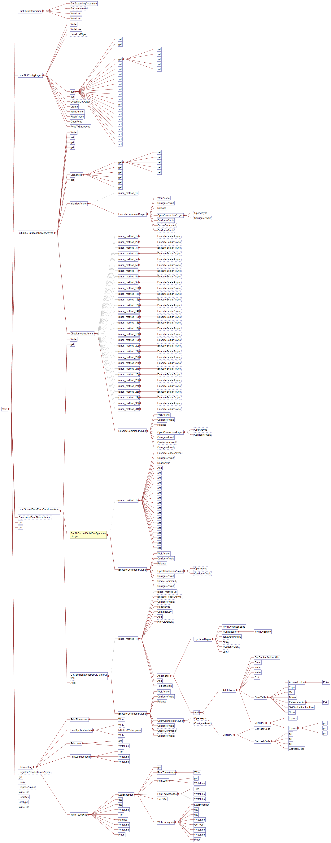
Call Graph
Most calls to asynchronous database
Some to synchronize between users

Slide 4
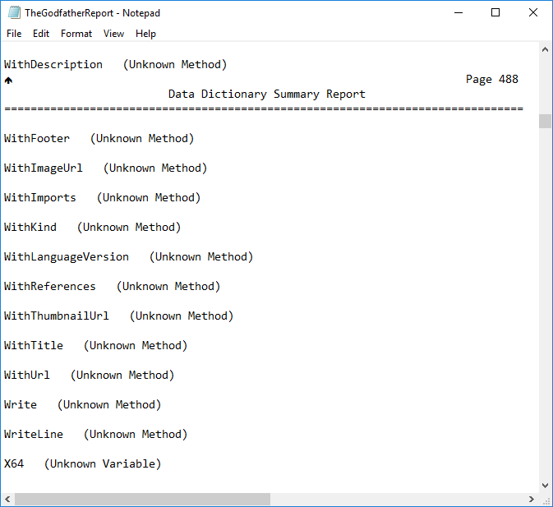
Data Dictionary
No definitions
Absolutely none

Slide 5
Additional Metrics
Low average complexity per-class
High coupling
Average class: 100 lines, 0 comments

Slide 6
Chosen Tasks
Remove/consolidate DSharpPlus dependency
Add Ubisoft player statistics module
Allows for low-risk refactoring
Allows for proof of gain from refactoring
Minimal risk to function

Slide 7
Questions

